Slide 1

Map Reduce Program

Slide 2
Writing the First Map Reduce Program

Slide 3

Program in Map Reduce
Hello World
Map Reduce Programs are usually written in JAVA
Hadoop has API called Streaming that can be used to write Map reduce program in Python, Ruby etc.
Create a Frequency distribution of words in a text file

Slide 4
Program in Map Reduce
Steps Involved
Step 1 : Write a Map Function
Step 2: Write a Reduce Function
Step 3: Setup a driver that points to your Map and reduce implementations

Slide 5
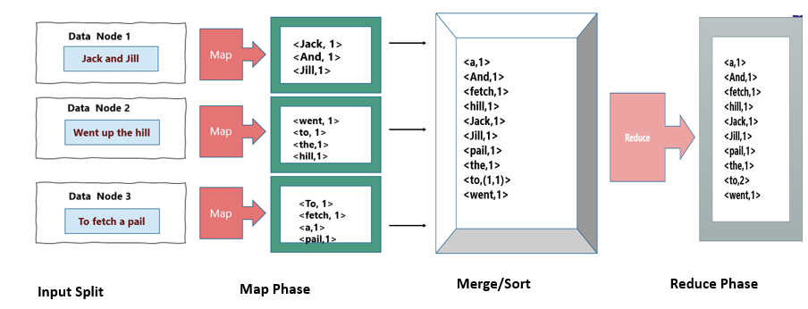
Program in Map Reduce
Hello World in Map Reduce

Slide 6
Program in Map Reduce
What I need to do to write a Map function in Java
Hadoop provides bunch of classes and the mapper class that we use here is the Base Class.
Main function that you will override is your Map function
To write a Mapper you extend the Map class and write your own map
WordMapper Class
Mapper Class

Slide 7
Program in Map Reduce
What is a Mapper?
Mapper is a generic class with 4 type parameters
While writing mapper function need to specify the type of input and output
WordMapper Class
<input key type,
input value type,
Output key type,
Output value type>
Mapper Class

Slide 8
Program in Map Reduce
What I need to do to write a reduce function in JAVA?
Hadoop provides a reducer class through which You will write
you reduce function
Reducer is a generic class with 4 type parameters
WordReducer Class
<input key type,
input value type,
Output key type,
Output value type>
Reducer Class

Slide 9
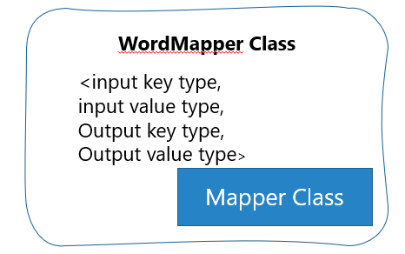
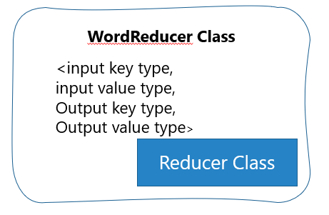
Program in Map Reduce
Do not forget
Output type of Mapper should match
To the input type of the reducer

Slide 10
Program in Map Reduce
Running the Map and reduce in Hadoop Infrastructure
Word Count Class
Job Object
Job needs to be configured with a bunch of properties
Job is a combination of all this
Input File Path
Output File Path
Mapper Class
Reducer Class
Output Data Types

Slide 11
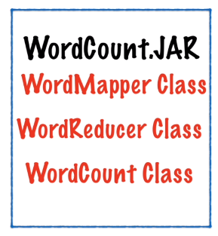
Program in Map Reduce
Running the Map and reduce in Hadoop Infrastructure
Word Mapper Class
One jar which contains everything
When you run a job, this gets distributed to all nodes
Word Reducer Class
Word Count Class

Slide 12
Mapper Code

Slide 13
Program in Map Reduce
Hello World in Map Reduce
Map() function is represented by the Mapper Class
<Jack,1>
<and,1>
<Jill,1>
<1, Jack and Jill>
Map ( )
Input: Line of Text
Output: <Word,1>

Slide 14
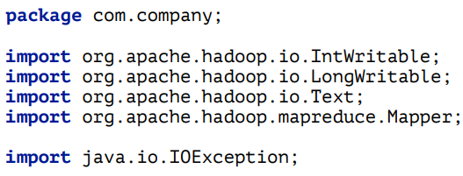
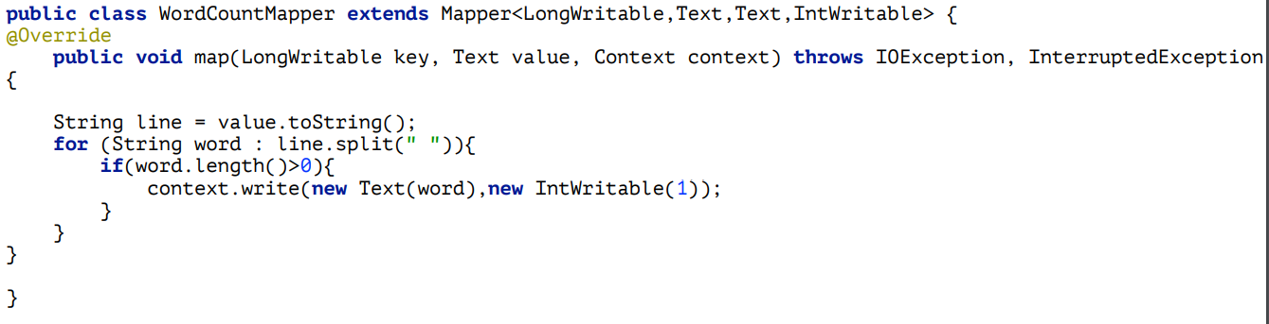
Program in Map Reduce
Mapper Code

Slide 15
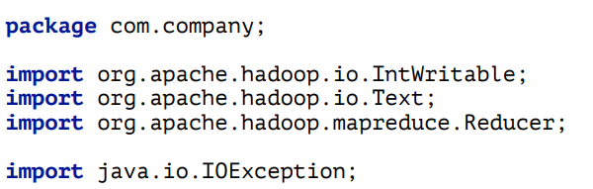
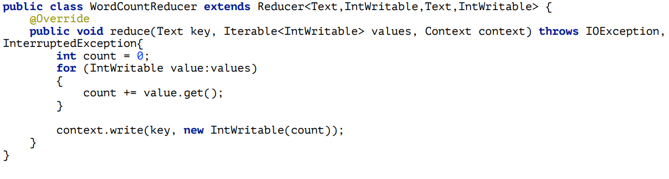
Program in Map Reduce
Reducer Code

Slide 16
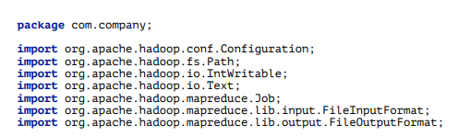
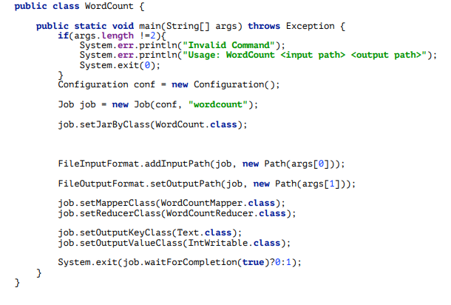
Program in Map Reduce
Driver Code

Slide 17
Program in Map Reduce
Running the Map and reduce in Hadoop Infrastructure
Word Count Class
Job Object
Job needs to be configured with a bunch of properties
Job is a combination of all this
Input File Path
Output File Path
Mapper Class
Reducer Class
Output Data Types

Slide 18
THANK YOU
“WORLD IS ONE BIG DATA PROBLEM”
“TORTURE THE DATA AND IT WILL CONFESS TO ANYTHING”

